Slide 1
3. Features of Java
Presented by S.R.Zameer

Slide 2
Features of Java
The Java Features given below are simple and easy to understand.
Simple
Object-Oriented
Platform independent
Robust
Portable
Dynamic
Interpreted
High Performance
Multithreaded
Distributed

Slide 3
Simple
According to Sun, Java language is simple because: syntax is based on C++ (so easier for programmers to learn it after C++).

Slide 4
Object-oriented
Object-oriented means we organize our software as a combination of different types of objects that incorporates both data and behavior.
Object-oriented programming(OOPs) is a methodology that simplify software development and maintenance by providing some rules.
Basic concepts of OOPs are:
Object
Class
Inheritance
Polymorphism
Abstraction
Encapsulation

Slide 5
Platform Independent
A platform is the hardware or software environment in which a program runs. There are two types of platforms software-based and hardware-based. Java provides software-based platform.
It has two components:
Runtime Environment
API(Application Programming Interface)

Slide 6
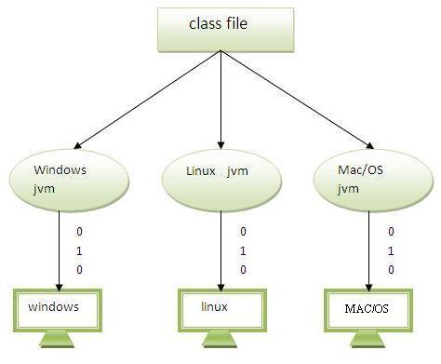

Slide 7
Robust
Robust simply means strong. Java uses strong memory management. There are lack of pointers that avoids security problem. There is automatic garbage collection in java. There is exception handling and type checking mechanism in java. All these points makes java robust.

Slide 8
Portable
We may carry the java byte code to any platform.

Slide 9
High-performance
Java is faster than traditional interpretation since byte code is "close“.

Slide 10
Distributed
We can create distributed applications in java.

Slide 11
Multi-threaded
A thread is like a separate program, executing concurrently. We can write Java programs that deal with many tasks at once by defining multiple threads. Threads are important for multi-media, Web applications etc.

